Slide 1
International Interdisciplinary Seminar Series in Romani Studies
Prof. Elena Marushiakova and Prof. Vesselin Popov
Institute of Ethnology and Social Anthropology at the Slovak Academy of Sciences
Brill Series Roma History and Culture: An Overview
Book Presentation: Elena Marushiakova and Vesselin Popov. 2024. Stalin vs Gypsies: Roma and Political Repressions in the USSR. Brill / Schöningh, 600 pp.

Slide 2
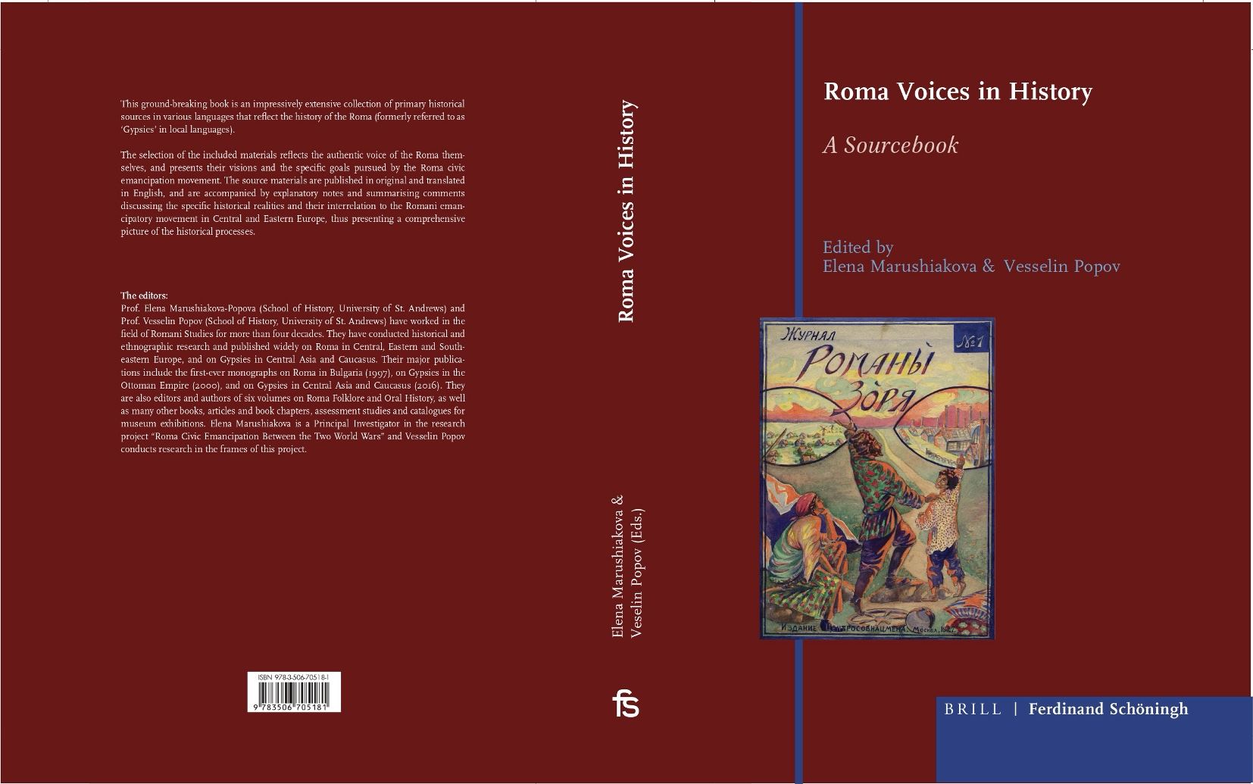

Slide 3


Slide 5

Roma History and Culture
Series Editors:
Elena Marushiakova
Vesselin Popov, and
Sofiya Zahova
Editorial Board / Council Member:
Ian F. Hancock OBE, FRSA,
Nadezhda Demeter,
Ion Duminica,
Jana Horváthová,
Tomasz Koper
Lilyana Kovacheva,
Hristo Kyuchukov

Slide 6
The overarching goal of the series is to integrate the history and culture of Roma into the mainstream of European and global academia. The published works offer innovative, critical, and, above all, reliable and thoroughly documented insights into Roma history and culture, relying on documents, critical rereading, and rethinking of historical sources and existing research. This approach represents a significant shift in the academic study of Roma history and culture, which in the past was often hindered by stereotypes, especially the false belief that there are not enough preserved written sources on the Roma past to establish Roma history as a distinct field. The series thus challenges and reshapes prevailing academic narratives that portray Roma only as a marginalised and detached community—passive objects subject to various state policies—by highlighting, analysing, and contextualising the agency of Roma as active participants with their own perspectives and visions for the development of their communities.

Slide 7


Slide 8


Slide 9


Slide 10


Slide 11


Slide 12


Slide 14


Slide 16
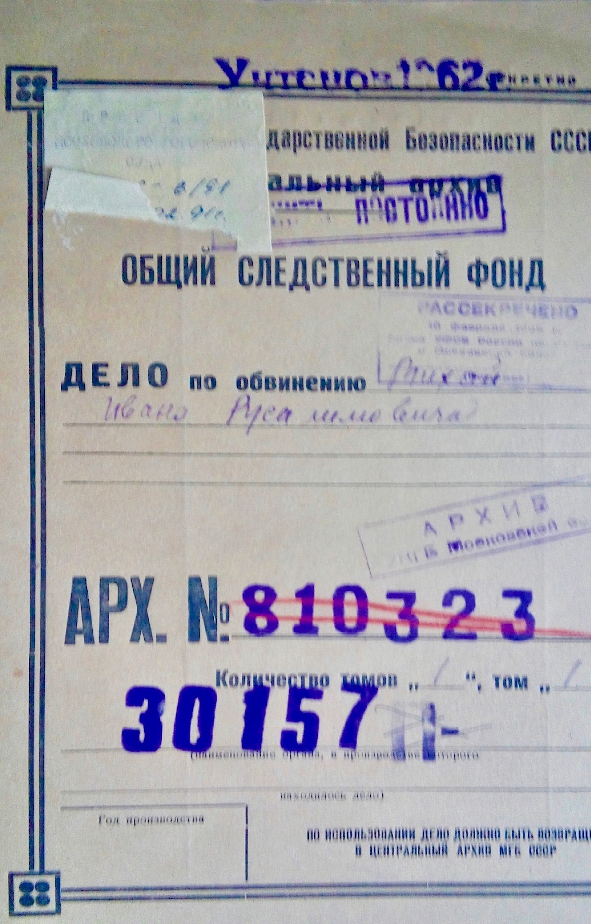
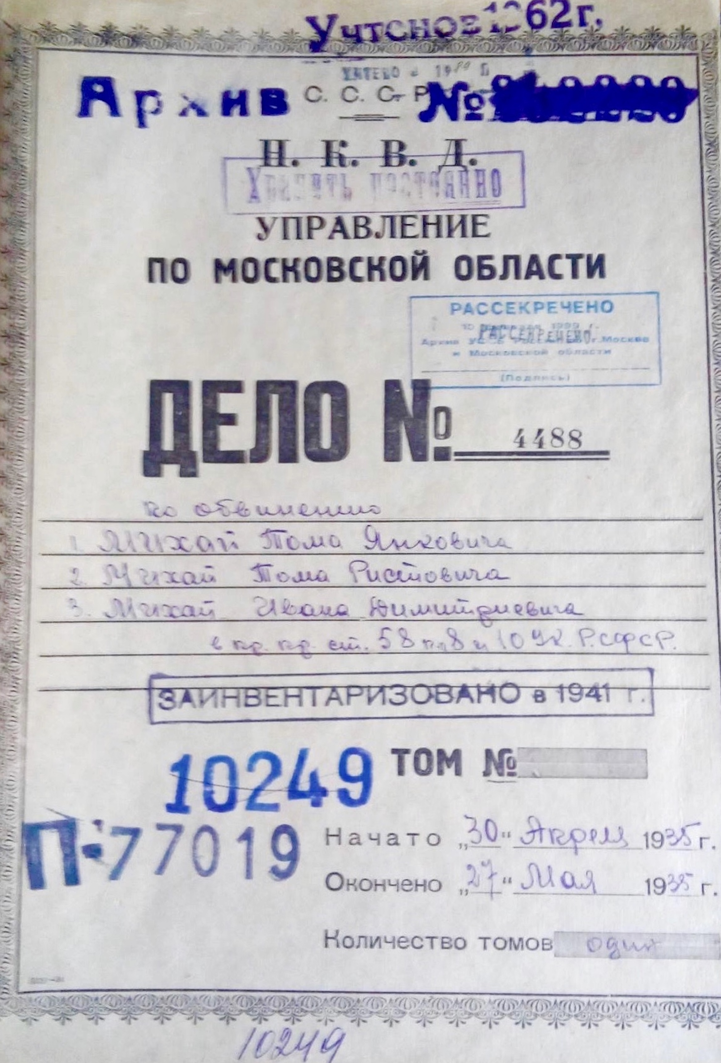

Slide 17
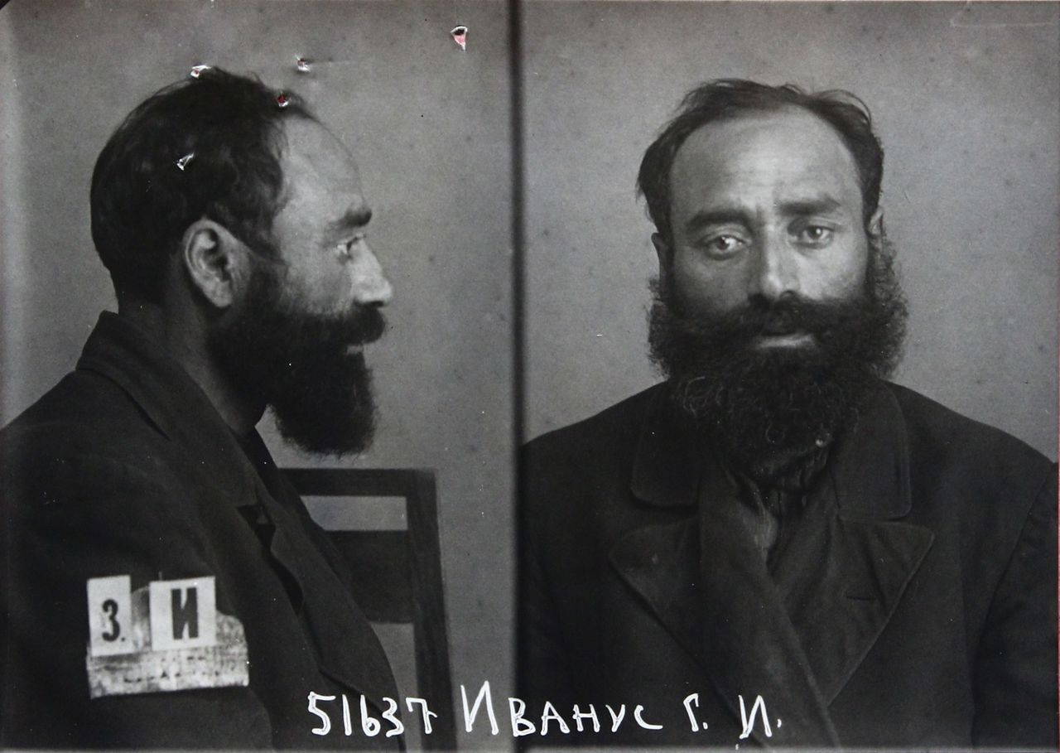

Slide 18
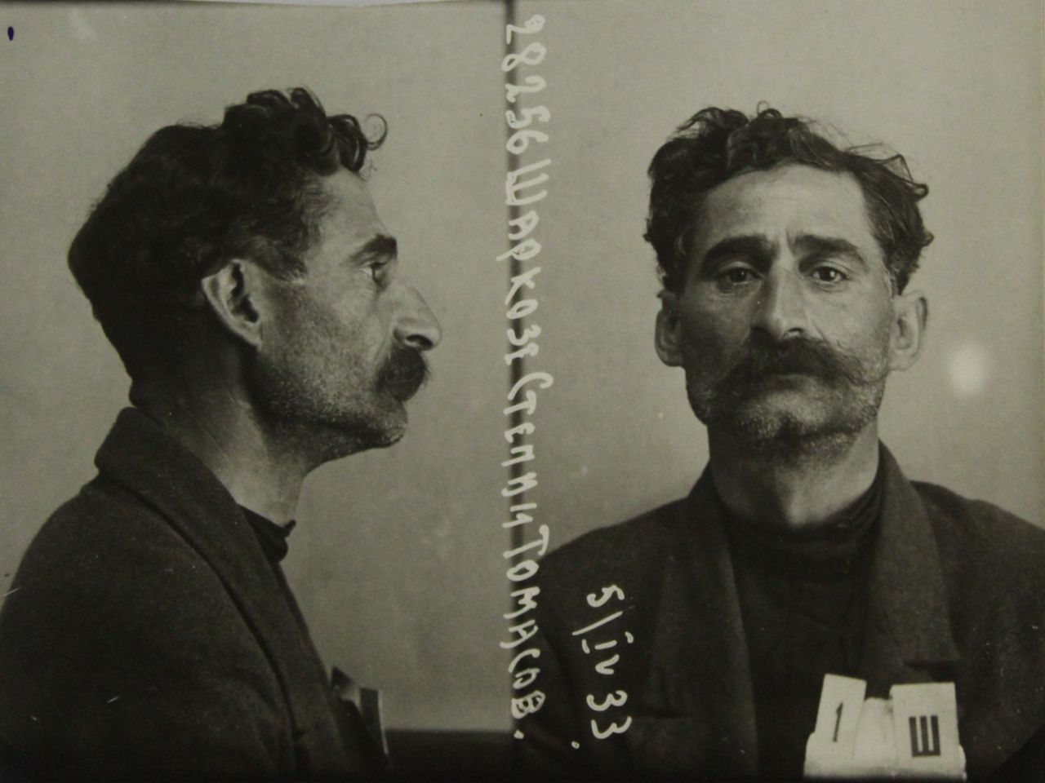

Slide 19
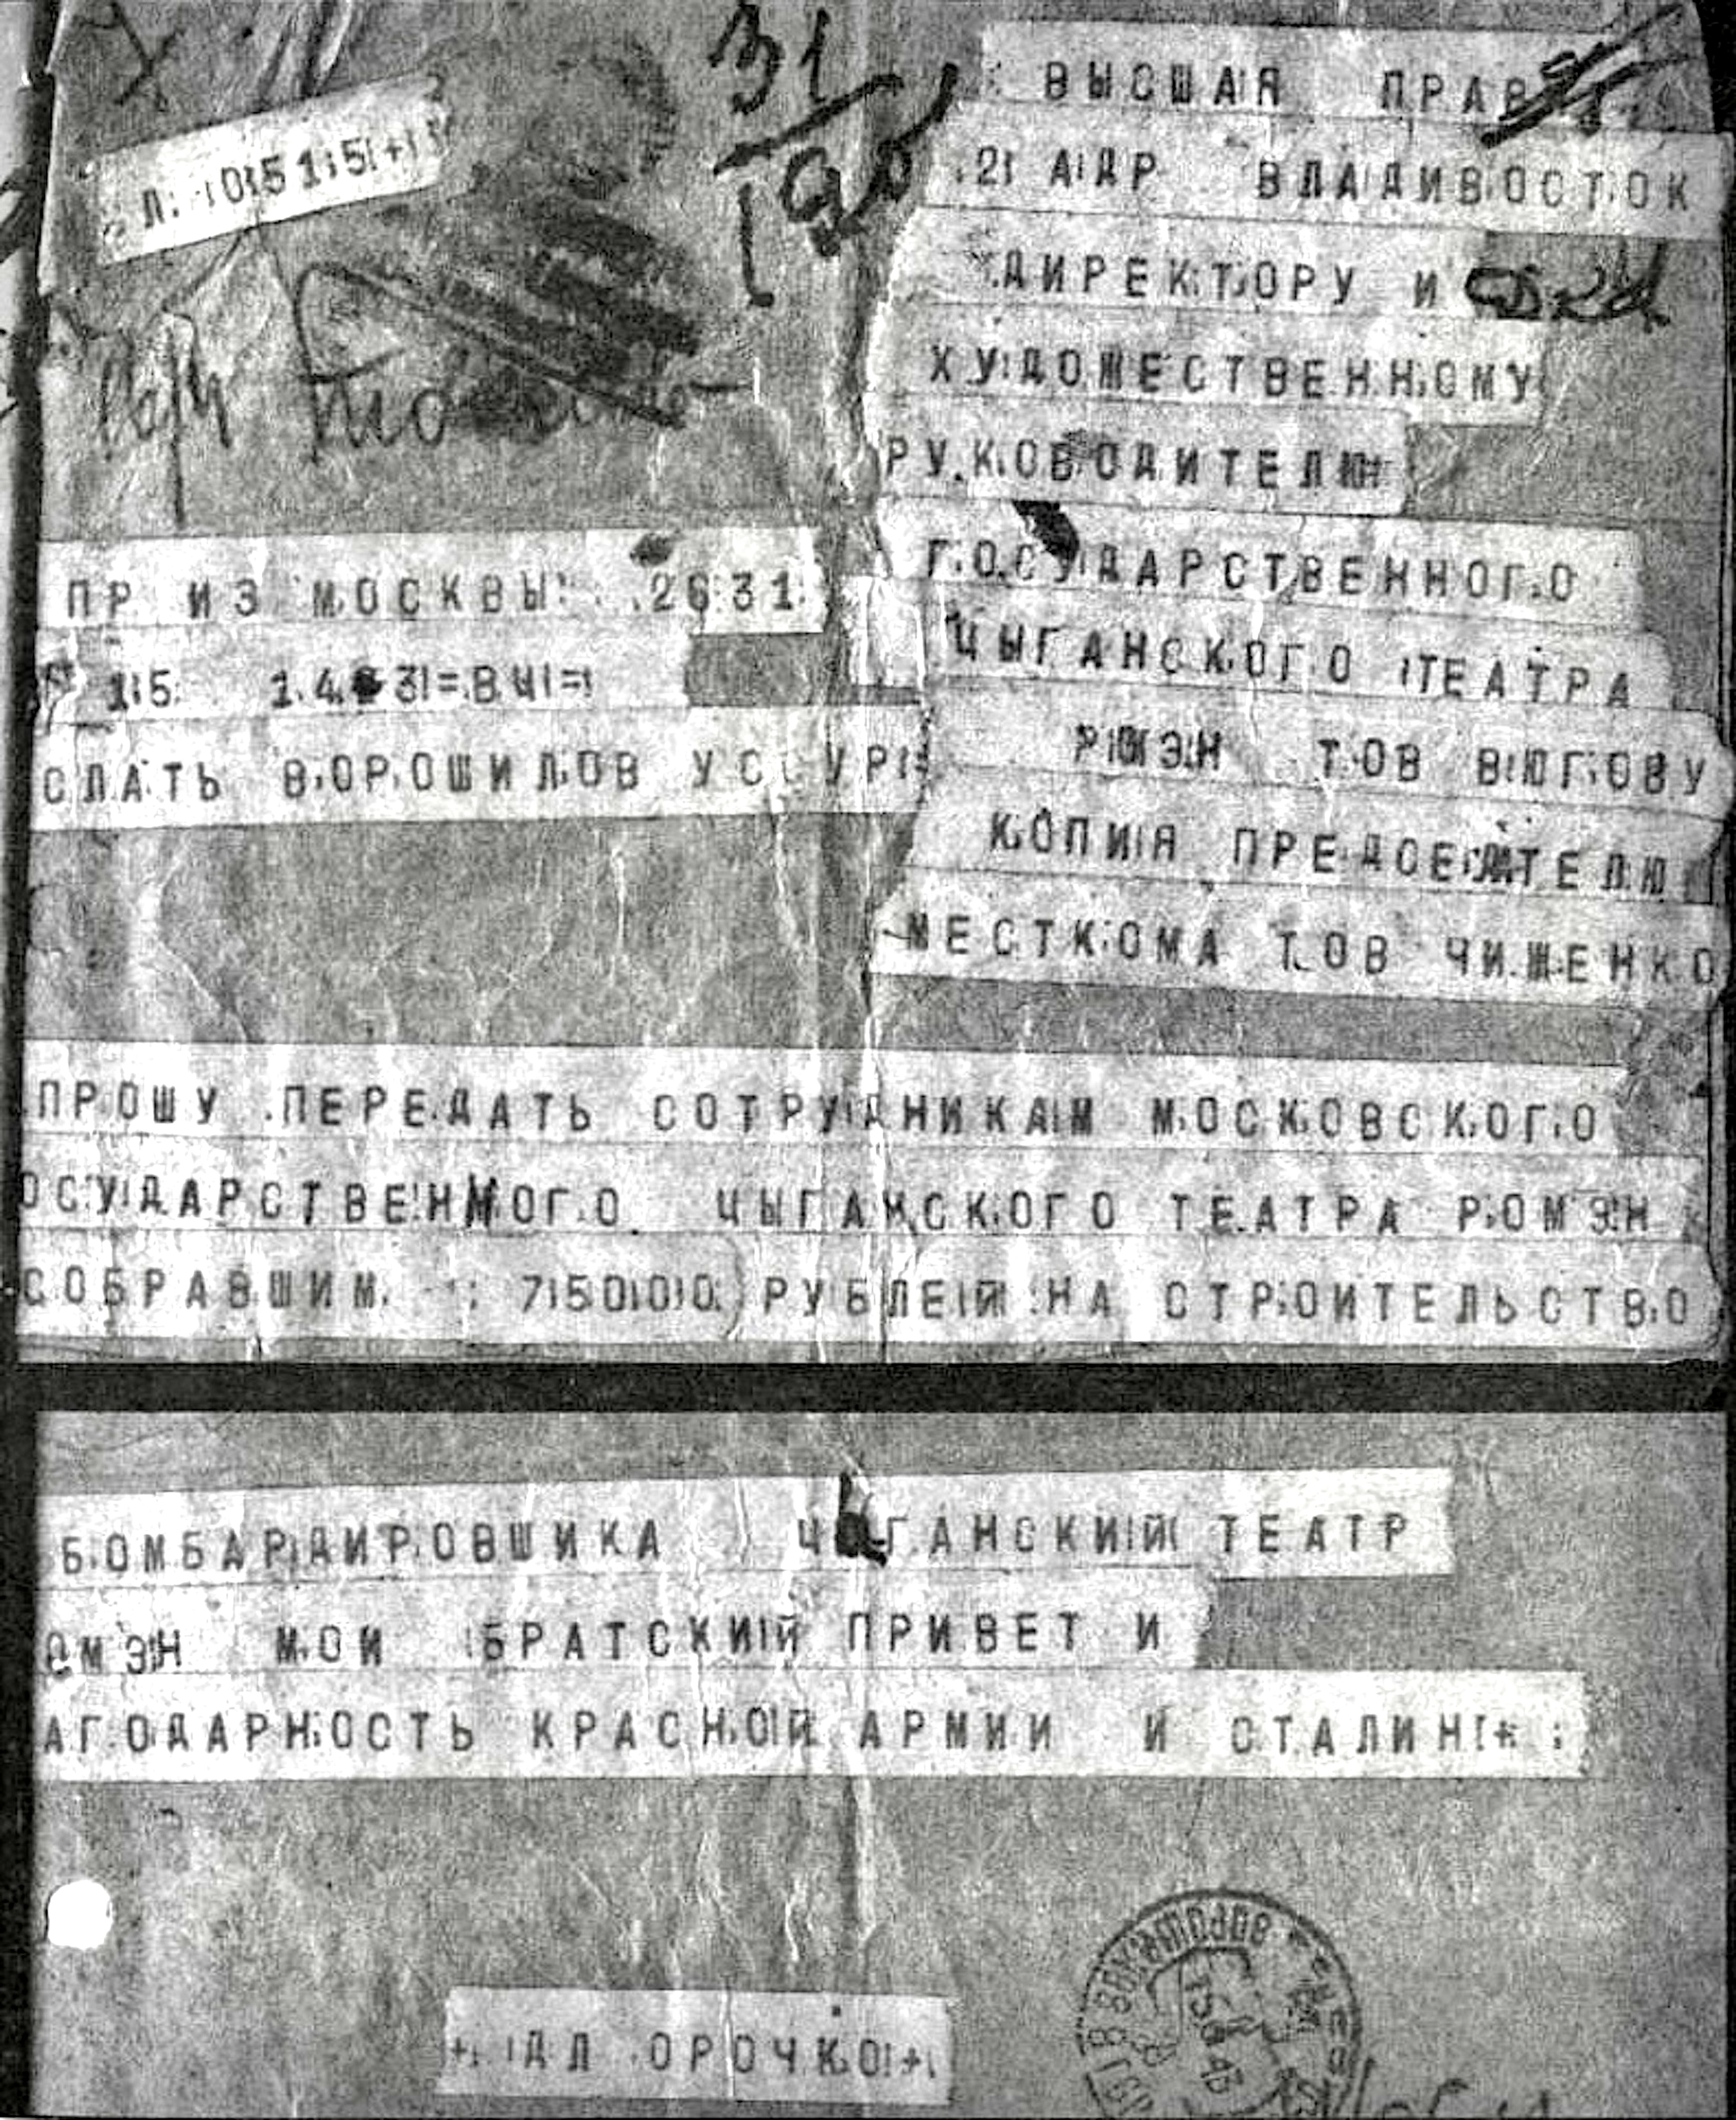

Slide 20
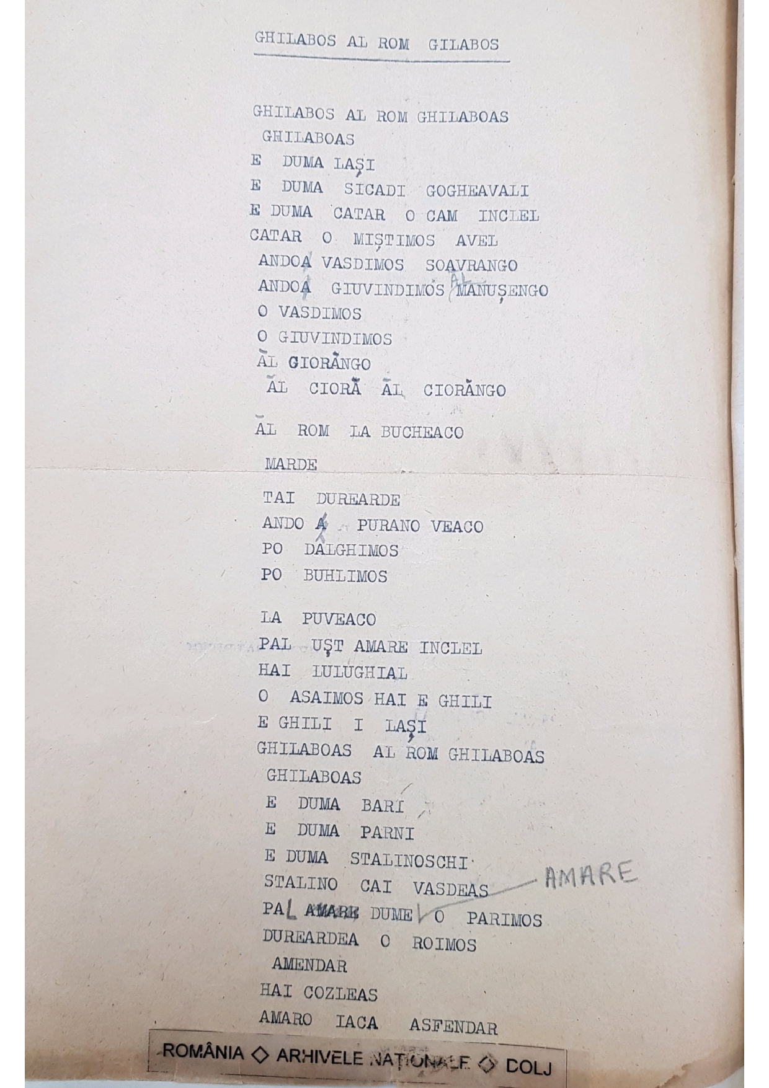

Slide 21
